Slide 1
INHERITANCE

Slide 2
class Base{
Base()
{
System.out.print("Base");
}
}
public class Derived extends Base{
Derived()
{
this("Examveda");
System.out.print("Derived");
}
Derived(String s)
{
System.out.print(s);
}
public static void main(String[] args){ new Derived(); } }

Slide 3
Inheritance
Why inheritance is required?
In the terminology of Java, a class that is inherited is called a superclass. The class that does the inheriting is called a subclass.
To inherit a class we simply incorporate the definition of one class into another by using the extends keyword.
The general form of a class declaration that inherits a superclass is shown here:
class subclass-name extends superclass-name
{
// body of class
}
Java does not support the inheritance of multiple super classes into a single subclass.
We can create a hierarchy of inheritance in which a subclass becomes a superclass of another subclass.
No class can be a superclass of itself.

Slide 4
extends
// A simple example of inheritance.
// Create a superclass.
class A {
int i, j;
void showij() {
System.out.println("i and j: " + i + " " + j);
}
}
// Create a subclass by extending class A.
class B extends A {
int k;
void showk() {
System.out.println("k: " + k);
}
void sum() {
System.out.println("i+j+k: " + (i+j+k));
}
}

Slide 5
class SimpleInheritance {
public static void main(String args[]) {
A superOb = new A();
B subOb = new B();
// The superclass may be used by itself.
superOb.i = 10;
superOb.j = 20;
System.out.println("Contents of superOb: ");
superOb.showij();
System.out.println();
/* The subclass has access to all public members of its superclass. */
subOb.i = 7;
subOb.j = 8;
subOb.k = 9;
System.out.println("Contents of subOb: ");
subOb.showij();
subOb.showk();
System.out.println();
System.out.println("Sum of i, j and k in subOb:");
subOb.sum();
}
}

Slide 6
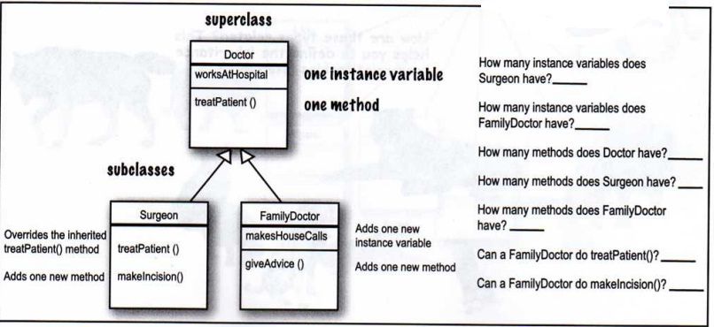

Slide 7
Member Access and Inheritance
Subclass cannot access those members of the superclass that have been declared as private.
// Create a superclass.
class A {
int i; // public by default
private int j; // private to A
void setij(int x, int y) {
i = x;
j = y;
}
}
// A's j is not accessible here.
class B extends A {
int total;
void sum() {
total = i + j; // ERROR, j is not accessible here
}
}

Slide 8
class Access {
public static void main(String args[]) {
B subOb = new B();
subOb.setij(10, 12);
subOb.sum();
System.out.println("Total is " + subOb.total);
}
}

Slide 9
A More Practical Example
class Box {
double width;
double height;
double depth;
Box(Box ob) {
width = ob.width;
height = ob.height;
depth = ob.depth;
}
Box(double w, double h, double d) {
width = w;
height = h;
depth = d;
}
Box() {
width = -1; // use -1 to indicate
height = -1; // an uninitialized
depth = -1; // box
}
Box(double len) {
width = height = depth = len;
}
double volume() {
return width * height * depth; } }

Slide 10
A More Practical Example
class BoxWeight extends Box {
double weight;
BoxWeight(double w, double h, double d, double m) {
width = w;
height = h;
depth = d;
weight = m;
}
}
class DemoBoxWeight {
public static void main(String args[]) {
BoxWeight mybox1 = new BoxWeight(10, 20, 15, 34.3);
BoxWeight mybox2 = new BoxWeight(2, 3, 4, 0.076);
double vol;
vol = mybox1.volume();
System.out.println("Volume of mybox1 is " + vol);
System.out.println("Weight of mybox1 is " + mybox1.weight);
System.out.println();
vol = mybox2.volume();
System.out.println("Volume of mybox2 is " + vol);
System.out.println("Weight of mybox2 is " + mybox2.weight);
} }

Slide 11
A Superclass Variable Can Reference a Subclass Object
class RefDemo {
public static void main(String args[]) {
BoxWeight weightbox = new BoxWeight(3, 5, 7, 8.37);
Box plainbox = new Box();
double vol;
vol = weightbox.volume();
System.out.println("Volume of weightbox is " + vol);
System.out.println("Weight of weightbox is " + weightbox.weight);
System.out.println();
// assign BoxWeight reference to Box reference
plainbox = weightbox;
vol = plainbox.volume(); // OK, volume() defined in Box
System.out.println("Volume of plainbox is " + vol);
/* The following statement is invalid because plainbox does not define a weight member. */
// System.out.println("Weight of plainbox is " + plainbox.weight);
}
}

Slide 12
Using super
Problems with previous example when using constructor.
The Super Keyword
Whenever a subclass needs to refer to its immediate superclass, it can do so by use of the keyword super.
super has two general forms.
1- The first calls the superclass’ constructor.
2- super is used to access a member of the superclass that has been hidden by a member of a subclass.

Slide 13
Using super to Call Superclass Constructors
A subclass can call a constructor defined by its superclass by use of the following form of super:
super(arg-list);
Here , arg-list specifies any arguments needed by the constructor in the super class.
super( ) must always be the first statement executed inside a subclass’ constructor.

Slide 14
Using super to Call Superclass Constructors
// BoxWeight now uses super to initialize its Box attributes.
class BoxWeight extends Box {
double weight; // weight of box
// initialize width, height, and depth using super()
BoxWeight(double w, double h, double d, double m)
{
super(w, h, d); // call superclass constructor
weight = m;
}
}

Slide 15
// A complete implementation of BoxWeight.
class Box {
private double width;
private double height;
private double depth;
Box(Box ob) { // pass object to constructor
width = ob.width;
height = ob.height;
depth = ob.depth;
}
Box(double w, double h, double d) {
width = w;
height = h;
depth = d;
}
Box() {
width = -1; // use -1 to indicate
height = -1; // an uninitialized
depth = -1; // box
}
Box(double len) {
width = height = depth = len;
}
double volume() {
return width * height * depth;
} }

Slide 16
// BoxWeight now fully implements all constructors.
class BoxWeight extends Box {
double weight; // weight of box
// construct clone of an object
BoxWeight(BoxWeight ob) { // pass object to constructor
super(ob);
weight = ob.weight;
}
// constructor when all parameters are specified
BoxWeight(double w, double h, double d, double m) {
super(w, h, d); // call superclass constructor
weight = m;
}
// default constructor
BoxWeight() {
super();
weight = -1;
}
// constructor used when cube is created
BoxWeight(double len, double m) {
super(len);
weight = m;
}
}

Slide 17
class DemoSuper {
public static void main(String args[]) {
BoxWeight mybox1 = new BoxWeight(10, 20, 15, 34.3);
BoxWeight mybox2 = new BoxWeight(2, 3, 4, 0.076);
BoxWeight mybox3 = new BoxWeight(); // default
BoxWeight mycube = new BoxWeight(3, 2);
BoxWeight myclone = new BoxWeight(mybox1);
double vol;
vol = mybox1.volume();
System.out.println("Volume of mybox1 is " + vol);
System.out.println("Weight of mybox1 is " + mybox1.weight);
System.out.println();
vol = mybox2.volume();
System.out.println("Volume of mybox2 is " + vol);

Slide 18
System.out.println("Weight of mybox2 is " + mybox2.weight);
System.out.println();
vol = mybox3.volume();
System.out.println("Volume of mybox3 is " + vol);
System.out.println("Weight of mybox3 is " + mybox3.weight);
System.out.println();
vol = myclone.volume();
System.out.println("Volume of myclone is " + vol);
System.out.println("Weight of myclone is " + myclone.weight);
System.out.println();
vol = mycube.volume();
System.out.println("Volume of mycube is " + vol);
  System.out.println("Weight of mycube is " + mycube.weight);
System.out.println();
}
}

Slide 19
A Second Use for super
The second form of super acts somewhat like this, except that it always refers to the superclass of the subclass in which it is used.
This usage has the following general form:
super.member
Here,member can be either a method or an instance variable.
This second form of super is most applicable to situations in which member names of a subclass hide members by the same name in the superclass.

Slide 20
class A {
int i;
}
class B extends A {
int i; // this i hides the i in A
B(int a, int b) {
super.i = a; // i in A
i = b; // i in B
}
void show() {
System.out.println("i in superclass: " + super.i);
System.out.println("i in subclass: " + i);
}
}
class UseSuper {
public static void main(String args[]) {
B subOb = new B(1, 2);
subOb.show();
}
}

Slide 21
Are superclass’s Constructor Inherited?
No. They are not inherited.
They are invoked explicitly or implicitly.
Explicitly using the super keyword.
A constructor is used to construct an instance of a class. Unlike properties and methods, a superclass's constructors are not inherited in the subclass. They can only be invoked from the subclasses' constructors, using the keyword super.
If the keyword super is not explicitly used, the superclass's no-arg constructor is automatically invoked.

Slide 22
Creating a Multilevel Hierarchy
// Extend BoxWeight to include shipping costs.
class Box {
private double width;
private double height;
private double depth;
Box(Box ob) { // pass object to constructor
width = ob.width;
height = ob.height;
depth = ob.depth;
}
Box(double w, double h, double d) {
width = w;
height = h;
depth = d;
}
Box() {
width = -1; // use -1 to indicate
height = -1; // an uninitialized
depth = -1; // box
}

Slide 23
Creating a Multilevel Hierarchy
Box(double len) {
width = height = depth = len;
}
double volume() {
return width * height * depth;
} }
class BoxWeight extends Box {
double weight; // weight of box
// construct clone of an object
BoxWeight(BoxWeight ob) { // pass object to constructor
super(ob);
weight = ob.weight;
}
BoxWeight(double w, double h, double d, double m) {
super(w, h, d); // call superclass constructor
weight = m;
}
BoxWeight() {
super();
weight = -1;
}
BoxWeight(double len, double m) {
super(len);
weight = m;
}
}

Slide 24
Creating a Multilevel Hierarchy
// Add shipping costs.
class Shipment extends BoxWeight {
double cost;
Shipment(Shipment ob) { // pass object to constructor
super(ob);
cost = ob.cost;
}
Shipment(double w, double h, double d, double m, double c) {
super(w, h, d, m); // call superclass constructor
cost = c;
}
Shipment() {
super();
cost = -1;
}
Shipment(double len, double m, double c) {
super(len, m);
cost = c; } }

Slide 25
Creating a Multilevel Hierarchy
class DemoShipment {
public static void main(String args[]) {
Shipment shipment1 =new Shipment(10, 20, 15, 10, 3.41);
Shipment shipment2 =new Shipment(2, 3, 4, 0.76, 1.28);
double vol;
vol = shipment1.volume();
System.out.println("Volume of shipment1 is " + vol);
System.out.println("Weight of shipment1 is "+ shipment1.weight);
System.out.println("Shipping cost: $" + shipment1.cost);
System.out.println();
vol = shipment2.volume();
System.out.println("Volume of shipment2 is " + vol);
System.out.println("Weight of shipment2 is “ + shipment2.weight);
System.out.println("Shipping cost: $" + shipment2.cost);
}
}

Slide 26
When Constructors Are Called in Multilevel Hierarchy
In a class hierarchy, constructors are called in order of derivation, from superclass to subclass.
super( ) must be the first statement executed in a subclass’ constructor.
If super( ) is not used, then the default or parameter less constructor of each superclass will be executed.

Slide 27
When Constructors Are Called in Multilevel Hierarchy
// Demonstrate when constructors are called.
// Create a super class.
class A {
A() {
System.out.println("Inside A's constructor.");
}
}
class B extends A {
B() {
System.out.println("Inside B's constructor.");
}
}
class C extends B {
C() {
System.out.println("Inside C's constructor.");
}
}
class CallingCons {
public static void main(String args[]) {
C c = new C();
} }

Slide 28
When Constructors Are Called in Multilevel Hierarchy
The output from this program is shown here:
Inside A’s constructor
Inside B’s constructor
Inside C’s constructor

Slide 29
Method Overriding
An instance method in a subclass with the same signature (name, plus the number and the type of its parameters) and return type as an instance method present in the superclass. Then the method in the subclass is said to override the method in the superclass.
When an overridden method is called from within a subclass, it will always refer to the version of that method defined by the subclass.
// Method overriding.
class A {
int i, j;
A(int a, int b) {
i = a;
j = b;
}
// display i and j
void show() {
System.out.println("i and j: " + i + " " + j);
}
}

Slide 30
Method Overriding
class B extends A {
int k;
B(int a, int b, int c) {
super(a, b);
k = c;
}
// display k – this overrides show() in A
void show() {
System.out.println("k: " + k);
}
}
class Override {
public static void main(String args[]) {
B subOb = new B(1, 2, 3);
subOb.show();
}
}

Slide 31
Method Overriding
When show( ) is invoked on an object of type B, the version of show( ) defined within B is used. That is, the version of show( ) inside B overrides the version declared in A.
If we want to access the superclass version of an overridden method, we can do so by using super. For example, in this version of B, the superclass version of show( ) is invoked within the subclass’ version. This allows all instance variables to be displayed.
class B extends A {
int k;
B(int a, int b, int c) {
super(a, b);
k = c;
}
void show() {
super.show(); // this calls A's show()
System.out.println("k: " + k);
}
}

Slide 32
Method Overriding
Method overriding occurs only when the names and the type signatures and return type of the two instance methods are identical.
If they are not, then the two methods are simply overloaded.
// Methods with differing type signatures are overloaded – not overridden.
class A {
int i, j;
A(int a, int b) {
i = a;
j = b;
}
// display i and j
void show() {
System.out.println("i and j: " + i + " " + j);
}
}

Slide 33
Method Overriding
// Create a subclass by extending class A.
class B extends A {
int k;
B(int a, int b, int c) {
super(a, b);
k = c;
}
// overload show()
void show(String msg) {
System.out.println(msg + k);
}
}
class Override {
public static void main(String args[]) {
B subOb = new B(1, 2, 3);
subOb.show("This is k: ");
subOb.show();
}
}

Slide 34
An instance method can be overridden only if it is accessible. Thus a private method cannot be overridden, because it is not accessible outside its own class.
Like an instance method, a static method can be inherited. However, a static method cannot be overridden. If a static method defined in the superclass is redefined in a subclass, the method defined in the superclass is hidden.

Slide 35
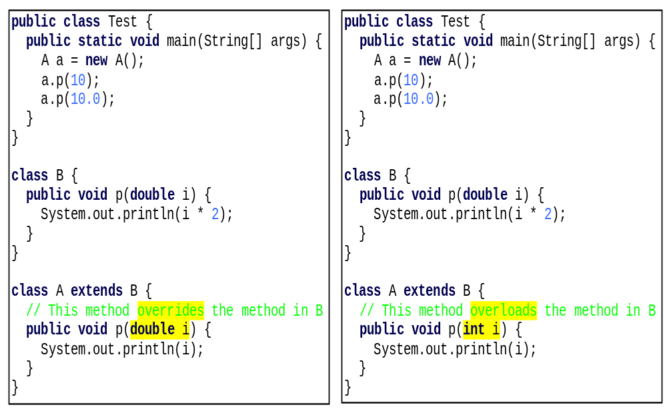
Overriding vs. Overloading

Slide 36
Static Methods Hiding
If a subclass defines a static method with the same signature as a static method in the superclass, then the method in the subclass hides the one in the superclass.

Slide 37
Overriding VS. Hiding
class A {
void call1() {
System.out.println("Inside A's instance method");
}
static void call2()
{
System.out.println("Inside A's static method");
}
}
class B extends A {
void call1() // override call1()
{
System.out.println("Inside B's instance method");
}
static void call2() // hides call2
{
System.out.println("Inside B's static method");
}
}

Slide 38
class my {
public static void main(String args[])
{
A a1 =new B();
a1.call1();
a1.call2();
}
}

Slide 39
Output:
Inside B's instance method
Inside A's static method

Slide 40
In instanceMethod() which B overrides the method from A, at run time the JVM uses the actual class of the instance a1 to determine which method to run. Although a1 was declared as a A , the actual instance we created was a new B(). So at runtime, the JVM finds that a1 is a B’s instance, and so it calls instanceMethod() in B rather than the one in A. That's how Java normally works for instance methods.

Slide 41
With classMethod() the compiler and JVM don't expect to need an actual instance to invoke the method. And even if you provide one (which we did: the instance referred to by a1) the JVM will never look at it.
The compiler will only look at the declared type of the reference, and use that declared type to determine, at compile time, which method to call. Since a1 is declared as type A, the compiler looks at A.classMethod(). It doesn't matter that the instance reffered to by a1 is actually a B - for static methods, the compiler only uses the declared type of the reference. That's what we mean when we say a static method does not have run-time polymorphism.
So for class methods, the runtime system invokes the method defined in the compile-time type of the reference on which the method is called.

Slide 42
A Subclass Cannot Weaken the Accessibility
A subclass may override a protected method in its superclass and change its visibility to public. However, a subclass cannot weaken the accessibility of a method defined in the superclass. For example, if a method is defined as public in the superclass, it must be defined as public in the subclass.

Slide 43

The Object Class and Its Methods
Every class in Java is descended from the java.lang.Object class. If no inheritance is specified when a class is defined, the superclass of the class is Object.

Slide 44
Dynamic Method Dispatch
Dynamic method dispatch is the mechanism by which a call to an overridden method is resolved at run time, rather than compile time.
Dynamic method dispatch is important because this is how Java implements run-time polymorphism.
A call to an overridden method is resolved at run time, rather than compile time.
A superclass reference variable can refer to a subclass object. Java uses this fact to resolve calls to overridden methods at run time.

Slide 45
Dynamic Method Dispatch
// Dynamic Method Dispatch
class A {
void callme() {
System.out.println("Inside A's callme method");
}
}
class B extends A { // override callme()
void callme() {
System.out.println("Inside B's callme method");
}
}
class C extends A { // override callme()
void callme() {
System.out.println("Inside C's callme method");
}
}

Slide 46
Dynamic Method Dispatch
class Dispatch {
public static void main(String args[]) {
A a = new A(); // object of type A
B b = new B(); // object of type B
C c = new C(); // object of type C
A r; // obtain a reference of type A
r = a; // r refers to an A object
r.callme(); // calls A's version of callme
r = b; // r refers to a B object
r.callme(); // calls B's version of callme
r = c; // r refers to a C object
r.callme(); // calls C's version of callme
}
}

Slide 47
Dynamic Method Dispatch
Overridden methods are another way that Java implements the “one interface, multiple methods” aspect of polymorphism.
Applying Method Overriding.
class Figure {
double dim1;
double dim2;
Figure(double a, double b) {
dim1 = a;
dim2 = b;
}
double area() {
System.out.println("Area for Figure is undefined.");
return 0;
}
}
class Rectangle extends Figure {
Rectangle(double a, double b) {
super(a, b);
}
double area() {
System.out.println("Inside Area for Rectangle.");
return dim1 * dim2;
}
}

Slide 48
class Triangle extends Figure {
Triangle(double a, double b) {
super(a, b);
}
// override area for right triangle
double area() {
System.out.println("Inside Area for Triangle.");
return dim1 * dim2 / 2;
}
}
class FindAreas {
public static void main(String args[]) {
Figure f = new Figure(10, 10);
Rectangle r = new Rectangle(9, 5);
Triangle t = new Triangle(10, 8);
Figure figref;
figref = r;
System.out.println("Area is " + figref.area());
figref = t;
System.out.println("Area is " + figref.area());
figref = f;
System.out.println("Area is " + figref.area());
}
}

Slide 49
output
Inside Area for Rectangle.
Area is 45
Inside Area for Triangle.
Area is 40
Area for Figure is undefined.
Area is 0

Slide 50
Using Abstract Classes
When we want to create a superclass that only defines a generalized form that will be shared by all of its subclasses, leaving it to each subclass to fill in the details.
When we want some way to ensure that a subclass does, indeed, override all necessary methods. Java’s solution to this problem is the abstract method.
To declare an abstract method, use this general form:
abstract type name(parameter-list);

Slide 51
Using Abstract Classes
abstract class A {
abstract void callme();
void callmetoo() {
System.out.println("This is a concrete method.");
}
}
class B extends A {
void callme() {
System.out.println("B's implementation of callme.");
}
}
class AbstractDemo {
public static void main(String args[]) {
B b = new B();
b.callme();
b.callmetoo();
}
}

Slide 52
Using Abstract Classes
Notice that no objects of class A are declared in the program.
It is not possible to instantiate an abstract class
// Using abstract methods and classes.
abstract class Figure {
double dim1;
double dim2;
Figure(double a, double b) {
dim1 = a;
dim2 = b;
}
// area is now an abstract method
abstract double area();
}

Slide 53
class Rectangle extends Figure {
Rectangle(double a, double b) {
super(a, b);
}
// override area for rectangle
double area() {
System.out.println("Inside Area for Rectangle.");
return dim1 * dim2;
}
}
class Triangle extends Figure {
Triangle(double a, double b) {
super(a, b);
}
// override area for right triangle
double area() {
System.out.println("Inside Area for Triangle.");
return dim1 * dim2 / 2;
} }

Slide 54
class AbstractAreas {
public static void main(String args[]) {
// Figure f = new Figure(10, 10); // illegal now
Rectangle r = new Rectangle(9, 5);
Triangle t = new Triangle(10, 8);
Figure figref; // this is OK, no object is created
figref = r;
System.out.println("Area is " + figref.area());
figref = t;
System.out.println("Area is " + figref.area());
}
}

Slide 55
The final Modifier
The final class cannot be extended:
final class Math {
...
}
The final variable is a constant:
final static double PI = 3.14159;
The final method cannot be
overridden by its subclasses.

Slide 56
Using final to Prevent Overriding
class A {
final void meth() {
System.out.println("This is a final method.");
}
}
class B extends A {
void meth() { // ERROR! Can't override.
System.out.println("Illegal!");
}
}

Slide 57
Using final to Prevent Inheritance
Sometimes you will want to prevent a class from being inherited. To do this, precede the class declaration with final.
Declaring a class as final implicitly declares all of its methods as final, too.
final class A {
// ...
}
// The following class is illegal.
class B extends A { // ERROR! Can't subclass A
// ...
}
Normally, Java resolves calls to methods dynamically, at runtime. This is called late binding .However, since final methods cannot be overridden, a call to one can be resolved at compile time. This is called early binding.

Slide 58

The protected Modifier
The protected modifier can be applied on data and methods in a class. A protected data or a protected method in a public class can be accessed by any class in the same package or its subclasses, even if the subclasses are in a different package.
private, default, protected, public

Slide 59

Accessibility Summary

Slide 60

Visibility Modifiers

Slide 61
NOTE
The modifiers are used on classes and class members (data and methods), except that the final modifier can also be used on local variables in a method. A final local variable is a constant inside a method.

